Slide 1
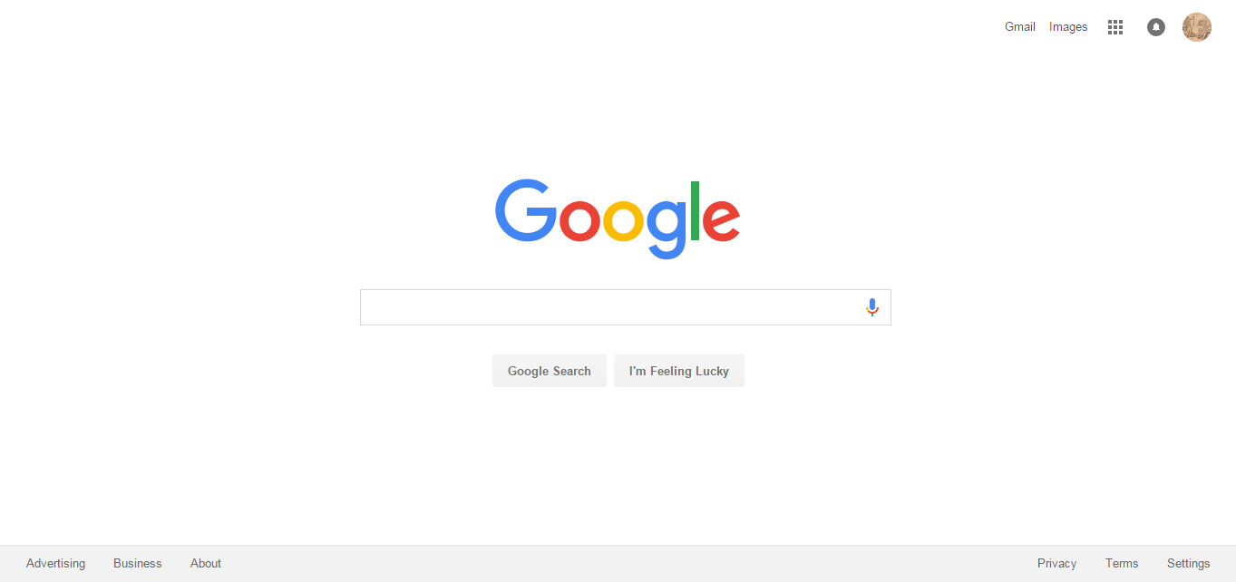

Slide 2
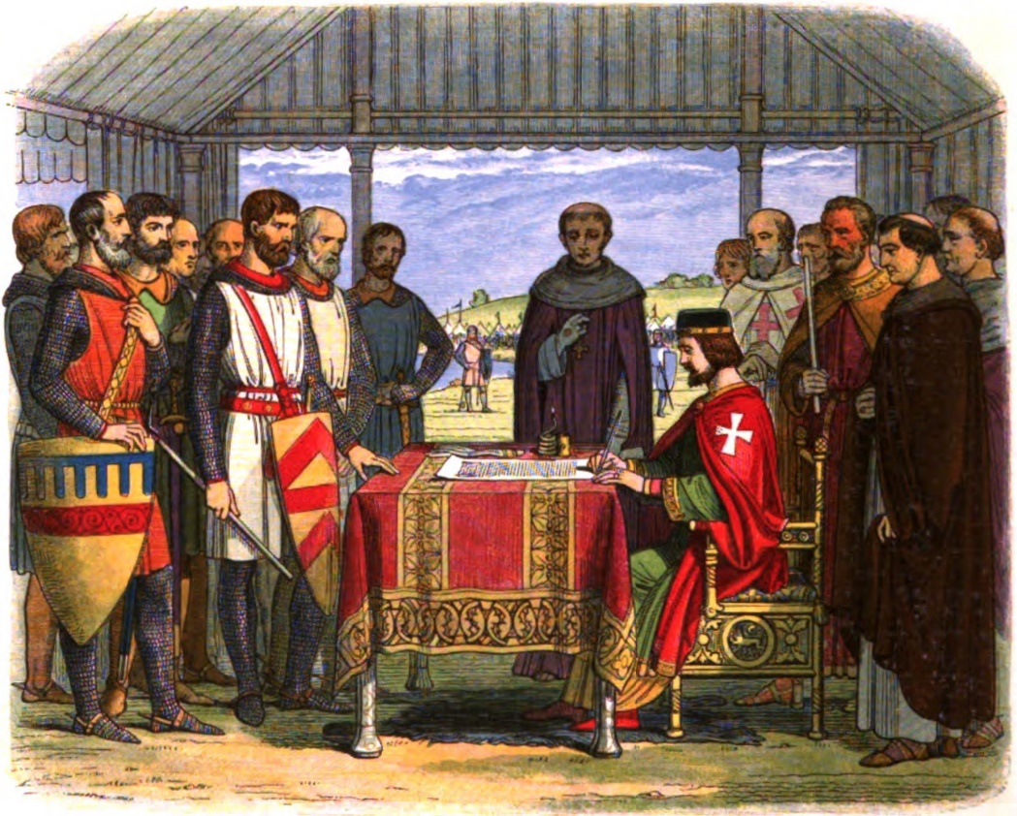
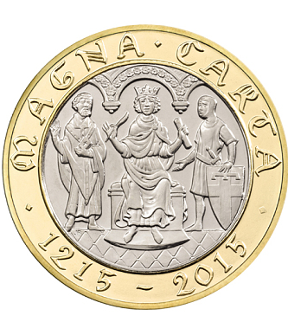
Stop!
Look!
Listen!

Slide 4
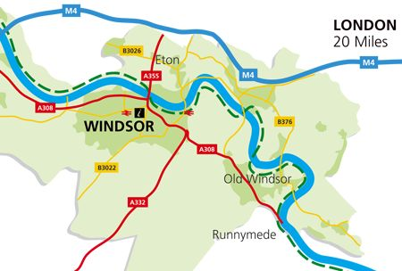

Slide 10
How to Force a King to Sign A Legal Document
Say you will pray for the king (it always seems to convince them).
If this does not work, say it will give the king more power (kings can not read).
If neither of these work, you can beg and plead and soon he will get annoyed and you will have won.

Slide 11
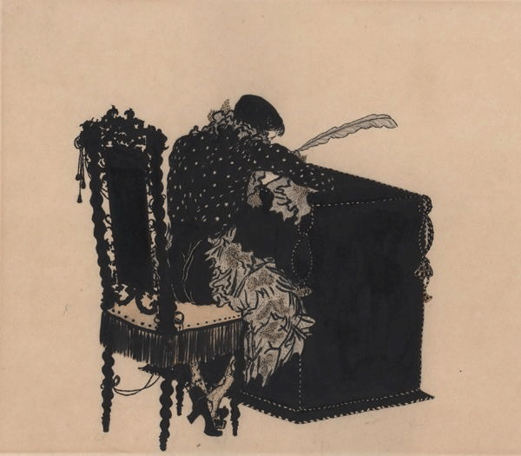
Petition: Get King John to sign the Magna Carta!

Slide 12
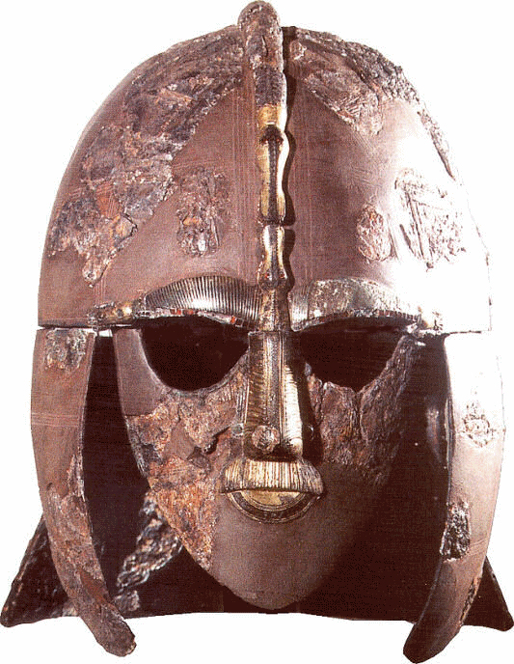
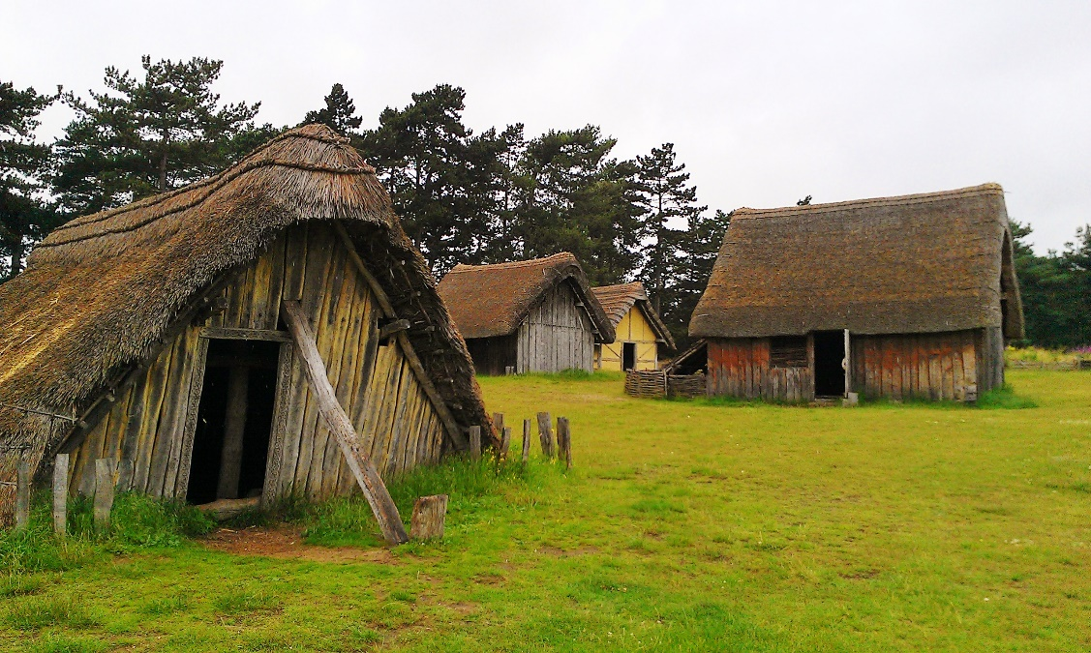
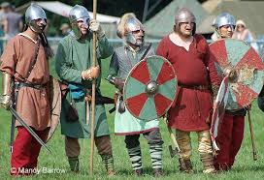
Anglo-Saxon People Collage

Slide 13
Noteworthy
King John was forced to sign the Magna Carta by the church; the Magna Carta gave the people more rights and king less power.
Alfred the Great united the many spread – out Anglo-Saxon kingdoms.
Henry II created the central court, and the two types of juries in it were the Grand Jury (decides if someone should be accused of a crime) and the Trial Jury (decides whether or not someone who is accused is guilty).

Slide 14
Quiz - Kahoot

